Slide 1
SUBJECT : OFFICE ADMINISTRATION
SCHOOL : MAGGOTTY HIGH
CLASS : 11B1
UNIT :
TOPIC :
TEACHER : Miss C. Mitchell
DATE :

Slide 2
Objectives:
Students should be able to:

Slide 3
What is a job interview?
A job interview is your chance to show an employer what kind of employee he or she will get if you're hired.

Slide 4
Types of interviews:
Face-to-face
Panel/committee
Telephone interview
Lunch/dinner interview

Slide 5
Preparing for an interview:
Selection of attire
Deportment
Prepare Educational Certificates as well as any other relevant documents
Research on the Organization
Type questions that may be asked by the interviewer and the interviewee
Conduct at an interview

Slide 6


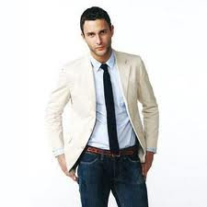

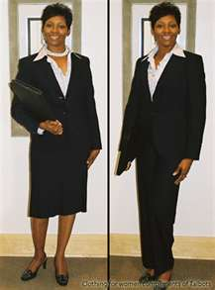
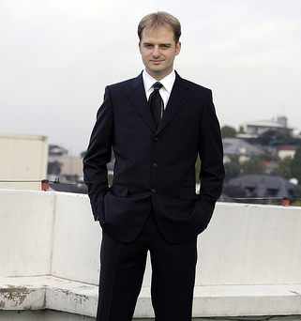

Selection of Appropriate Attire:

Slide 7
How attire for an interview:
Men's Interview Attire
Suit (solid color - navy or dark grey)
Long sleeve shirt (white or coordinated with the suit)
Belt
Tie
Dark socks, conservative leather shoes
Little or no jewelry
Neat, professional hairstyle
Limit the aftershave
Neatly trimmed nails
Portfolio or briefcase

Slide 8
Attire cont’d
Women's Interview Attire
Suit (navy, black or dark grey)
The suit skirt should be long enough so you can sit down comfortably
Coordinated blouse
Conservative shoes
Limited jewelry (no dangling earrings or arms full of bracelets)
No jewelry is better than cheap jewelry
Professional hairstyle
Neutral pantyhose
Light make-up and perfume
Neatly manicured clean nails
Portfolio or briefcase

Slide 9
Possible question that may be asked by an interviewer:
Tell me about yourself (in two minutes).
Why do you feel that you will be successful in ...?
Why did you decide to interview with our organization?
Are you willing to relocate?
Why did you choose your major?
Tell me about your scholastic record.
What courses did you like best? least? Why?
Tell me about your extra-curricular activities and interests.

Slide 10
Possible question s that can be asked by an interviewee:
How would you describe the responsibilities of the position?
How would you describe a typical week/day in this position?
Is this a new position? If not, what did the previous employee go on to do?
What is the company's management style?
Who does this position report to? If I am offered the position, can I meet him/her?
How many people work in this office/department?
How much travel is expected?
Is relocation a possibility?

Slide 11
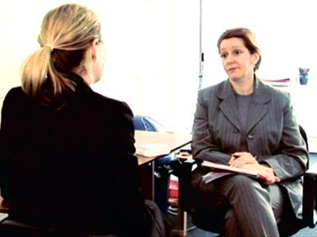


Typical layout for an interview

